Slide 1

HIV disparity in
minority America
Team: Terrible Name
Aggie Hacks x Google Cloud

Slide 2
TABLE OF CONTENTS
01
01
04
Disparity Overview
01
Gender Difference
02
05
01
State Difference
01
Housing Difference
03
06
01
Health Care Difference
01
Recommendations
Notes:
We will be covering the different aspects of racial disparity among the HIV patients in US. We analysed this disparity on state level, on the health care access for difference races, gender differences among different communities and how densely populated black neighbourhoods also corroborate to this. After presenting our claims, we want to make some possible recommendations to control these disparities in our society.

Slide 3

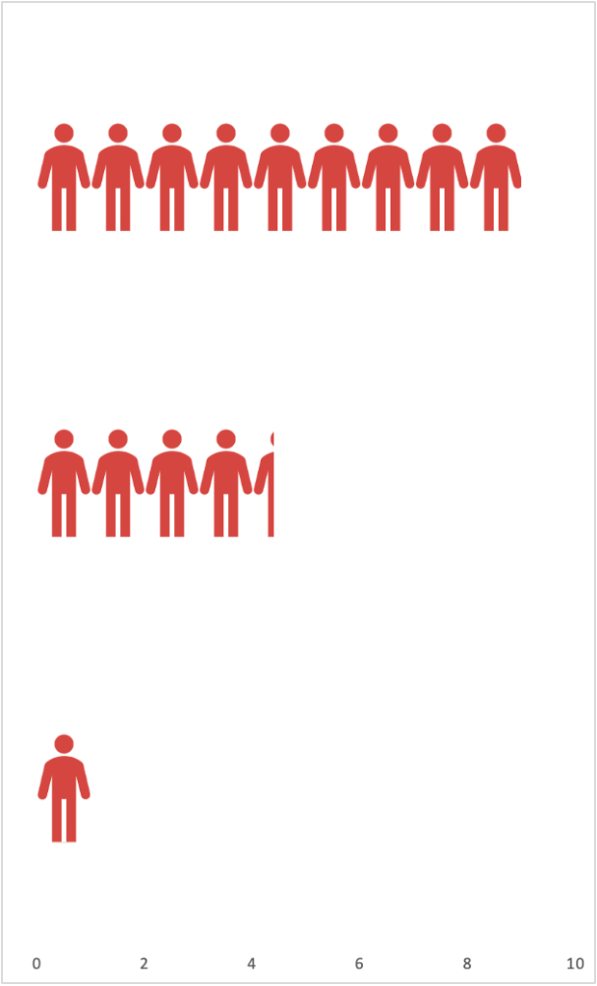
Black minority disproportionally suffers from HIV epidemic
2010-2019 HIV Total Cases
2019 HIV New Cases
Black
45%
Hispanic
28%
White
27%
1.Disparity Overview
1
Notes:
The graph shows the newly diagnosed HIV cases in 2019 among the different races in the US.
We can clearly see that the black community have much higher cases than any other.
For the new cases, every white people gets infection, it will have 4.4 Hispanics and 9 Blacks get infected.
Note: The HIV cases among black people compared to white are almost 9-10 times higher than the white community.

Slide 4
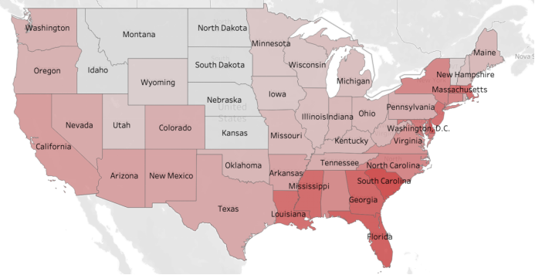
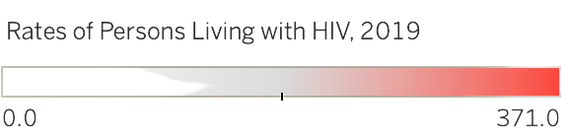
HIV epidemic is worst in East and South
2.State Difference
2
Notes:
The geographical map of the US shows the intensity of the rate of total active cases for each state.
From this graph, we can easily interpret that Eastern and Southern US have a much higher rate of HIV infections than other parts of the continental United States.

Slide 5

Black community has less access to health care
1M+ people living with HIV in the US
78% in Black people and 84% in White people are aware
73% in Black people and 79% in White people are linked with primary care
61% in Black people and 72% in White people are virally suppressed
3.Health Care Difference
3
Notes:
As per the UN recommendations, 90% of actual HIV patients should be aware of their status, but only 78% in blacks and 84% in whites.
Out of all the users who are HIV positive, 90% should be linked with patient care, only 73% blacks but 79% white people are linked with primary care.
Out of all the users who are linked with HIV care, 90% should be virally suppressed, only 82% black (calculated) but 90% of the white population are virally suppressed.
This image shows how there is a clear racial disparity in society when it comes to the treatment of HIV cases. We can clearly analyze from the plot that even though black people have much higher numbers for HIV diagnosis rate, only a handful of them actually receive any treatment or linked care within 3 months. On the other hand, there is a high percentage of white people who received linked care after getting diagnosed with HIV.

Slide 6
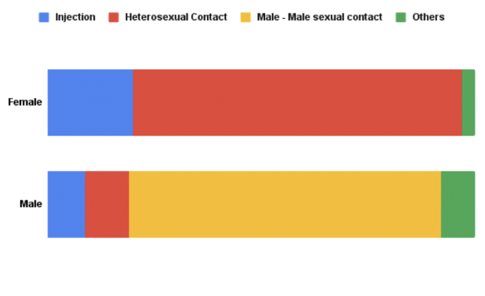
Females are more susceptible to injection-related HIV transmission
Female Infection Rate in Newly Diagnosed Cases
Government policies are already in place to mitigate sexual transmission of HIV
No federal policies focusing on injection-related transmissions of HIV
4.Gender Difference
4
Notes:
The plot on the left shows the different ways in which males and females can contract HIV. One of the most overlooked differences is the proportion of women getting infected due to the use of infected syringes. We will see later in the recommendation 2 that how Washington, D.C. was able to reduce the number of infections after implementing needle exchange program.
This is an important part of the puzzle of solving racial disparity.

Slide 7
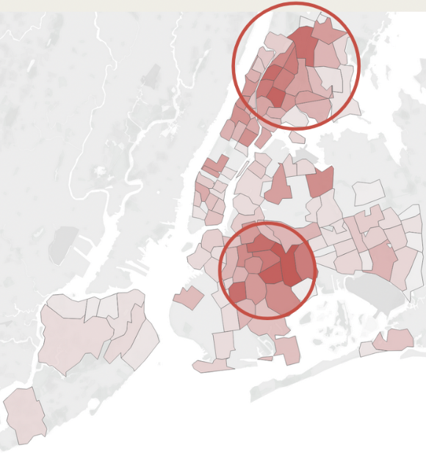
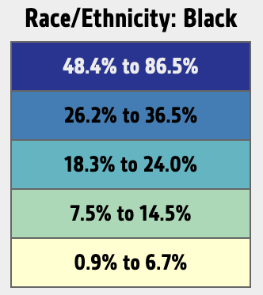
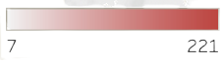
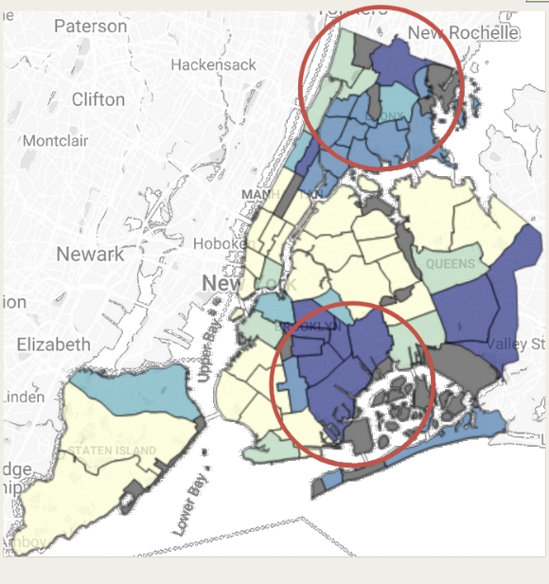
HIV cases are the highest among black neighborhoods
NYC HIV Infection by District Map
NYC Black people residency by District Map
HIV Cases
4.Housing Difference
5
Notes:
The plot on the left shows the density of the HIV infections by district in the New York City.
The plot on the right shows the major black communities living in the same region. We can see that there is a clear correlation between the high density of HIV infections and the black neighbourhoods..

Slide 8
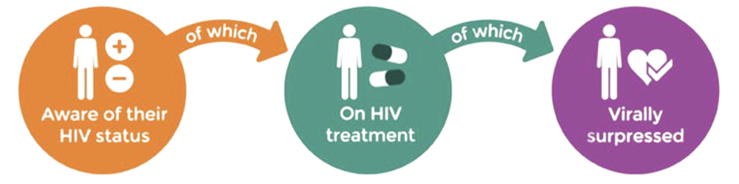
Recommendation 1
Modify and adopt South African 90-90-90 program
90%
90%
90%
Ramp up government testing facilities which are lying dormant in many parts of country due to emergence of self-testing kits.
The 90-90-90 plan also states to start antiretroviral therapy regardless of the CD4 count. This is based on a “human rights based test-and-offer” approach.
Implement a widespread infant HIV testing program, where kids are tested soon after birth. An estimated 8500 kids are born with HIV every year in the USA.
6
Notes:
Our first recommendation is to implement a 90-90-90 strategy.
The main components of 90-90-90 strategy are:
90% of all people who have AIDS should be detected early enough for treatment to take effect.
90% of all people who have been diagnosed should be linked to primary HIV healthcare.
90% of all people who are linked to healthcare should be virally suppressed.
This strategy which was first implemented in South Africa, has shown remarkable improvements in the HIV situation in country, which was once ravaged by the disease. A similar program in US, taking into account the cultural and socio-economic complications, should be implemented to improve upon the current disparity in HIV infections in minorities.
The benefits of the 90-90-90 method:
1. Early detection and treatment will lead to lower transmission. This has resulted into an estimated 3.3 million new cases.
2. Early treatment has massive economic gains by preventing users from requiring expensive and long-term treatments. It has saved South Africa nearly 30 billion dollars over the last few decades.

Slide 9
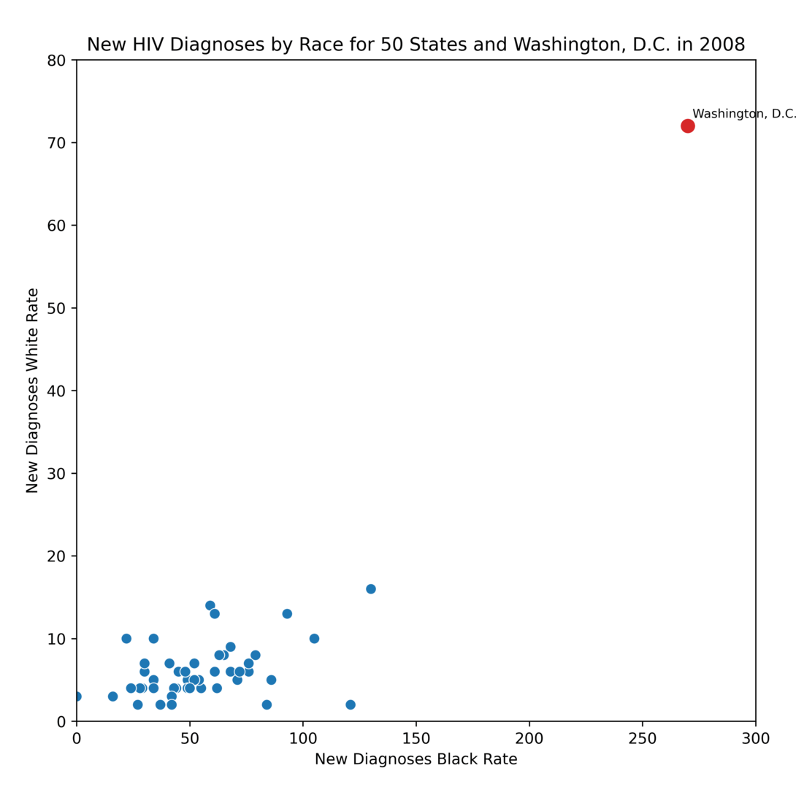
Recommendation 2
Federal needle exchange program and better reporting
In 2006-2008, the following policies were implemented in Washington, D.C. to curb HIV cases:
Implementation of expanded city-wide HIV testing initiative
DC needle exchange program
The plot on the left shows how the cases reduced dramatically over the years after the policies were in place
7
Notes:
The above plots show how the cases in Washington DC declined over the years (2008-2019) due to the launch of new policies.
Washington DC had one of the highest rates for newly diagnosed HIV cases since 1983. In 2006, the state government started a new program called, “Implementation of expanded city-wide HIV testing initiative” which had a new name-based reporting system. The first effect of this was the number of cases increased as more people were recorded than earlier due to this new policy. In 2008, the government launched, “DC needle exchange program”, which had a massive impact on the spread of infection. In this program, anyone could exchange an old needle with a new, sterilized one. Both these policies had a massive impact on the city’s newly diagnosed rates and as a result, the trend has been decreasing. We can conclude that such policies like these can really help in controlling the spread of infection.

Slide 10
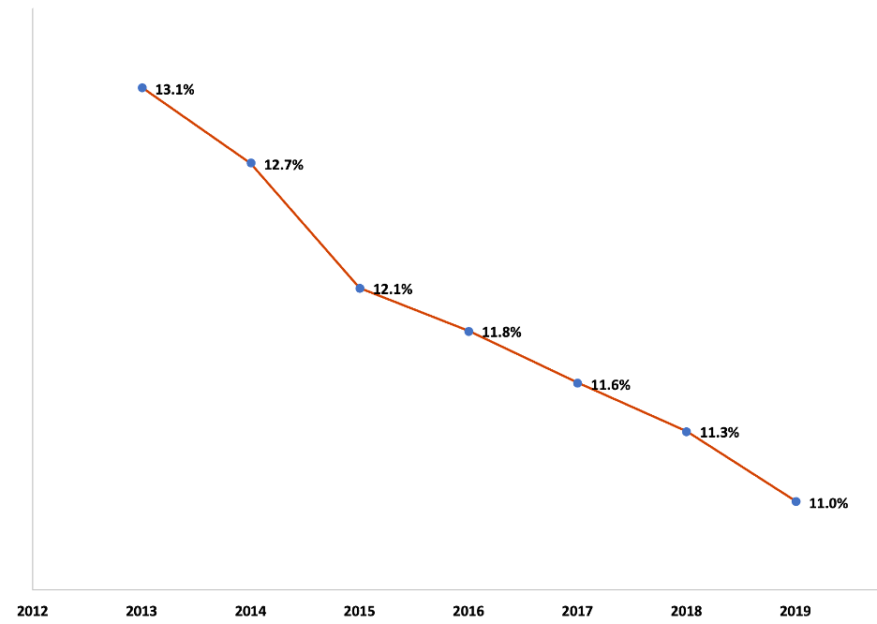
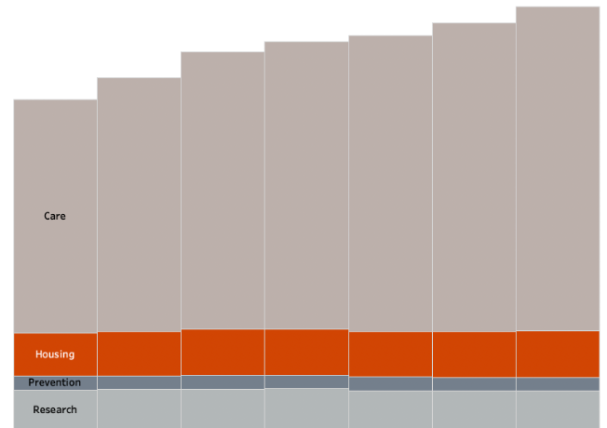
Recommendation 3
Increase the housing and HIV research funding
2013-2019 Federal Funding for HIV/AIDS (US$ Billions)
2013-2019 Housing Funding Percentage
17
8
Notes:
The chart on the left shows the total increase in HIV-AIDS funding but no increase in housing or HIV research. The chart on the right shows the decrease in housing funding as a percentage of total. As we discussed earlier, communities with higher density of minorities have a higher rate of HIV cases. Most minorities live in densely populated, low income neighborhood and hence, we need to invest in improving the housing conditions, especially for patients already living with HIV, to decrease the chances of getting an infection. It might also be worth considering to increase research funding.

Slide 11



x
Thank you!

Slide 12
References
https://www.cdc.gov/nchhstp/newsroom/fact-sheets/hiv/black-african-american-factsheet.html
https://aidsvu.org/local-data/united-states/
https://www1.nyc.gov/site/doh/data/data-sets/hiv-aids-annual-surveillance-statistics.page
https://data.unicef.org/resources/dataset/hiv-aids-statistical-tables/
https://ourworldindata.org/hiv-aids
https://www.intechopen.com/chapters/62037
https://www.unaids.org/en/resources/909090
https://wtop.com/dc/2022/02/reasons-for-optimism-and-caution-in-dcs-annual-hiv-report/

